Slide 1

SOAER Update: Approach

Slide 2
SOAER Update: Identifying Priorities
SOAER Committee priority setting exercise (virtual fall/winter 2021): Committee members identified priority data gaps and aspects of the website that they would like to be improved.
SOAER Committee Workshop (November 2022): SOAER Committee members met in Yellowknife and further refined the list of priorities. Started to explore "how".
U of Calgary Workshop (March 2023): Workshop invited representatives from the basin to meet and discuss recommendations and preferences for "State Of" reporting. Participants shared priorities for the type of information and ideas of how to share information
SOAER Session at the NWT Water Stewardship Meeting (October 2024): Session focused on sharing the 2021 SOAER, discussion of 2021 SOAER data gaps, and ideas/suggestions for future reporting

Slide 3
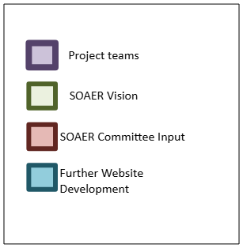
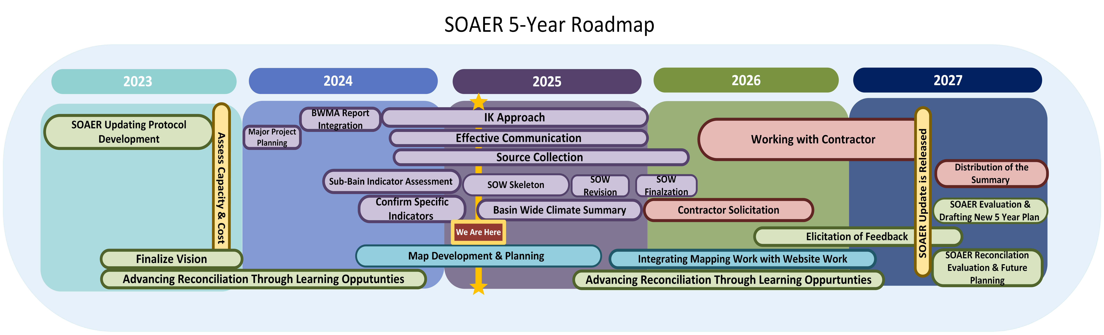

Slide 4
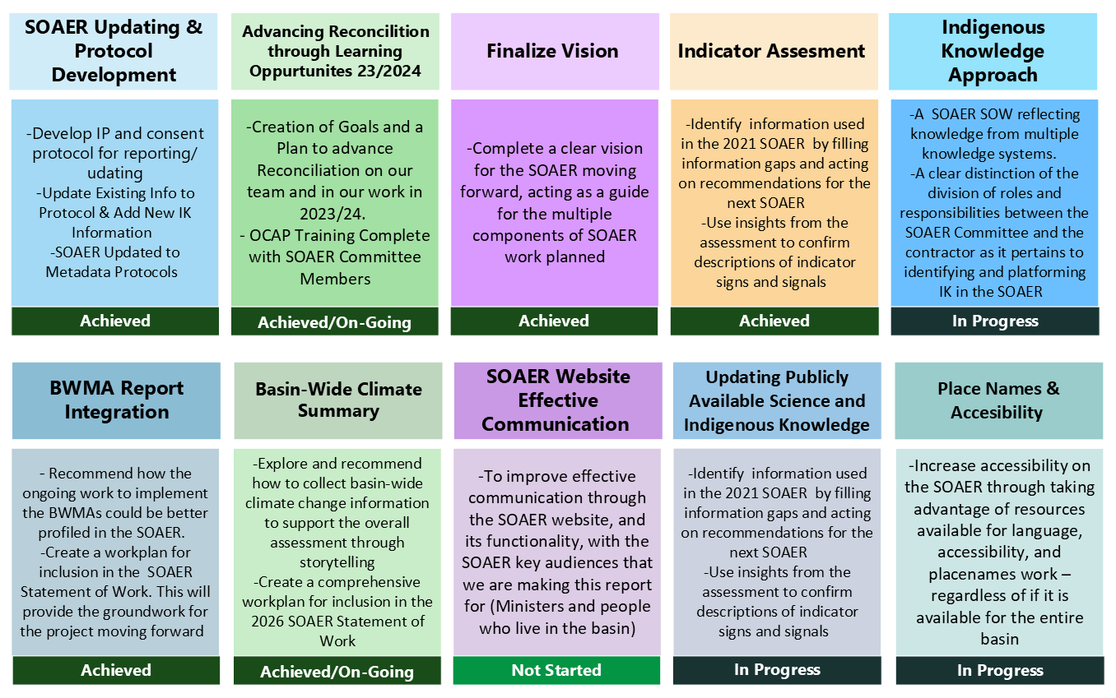


Slide 5
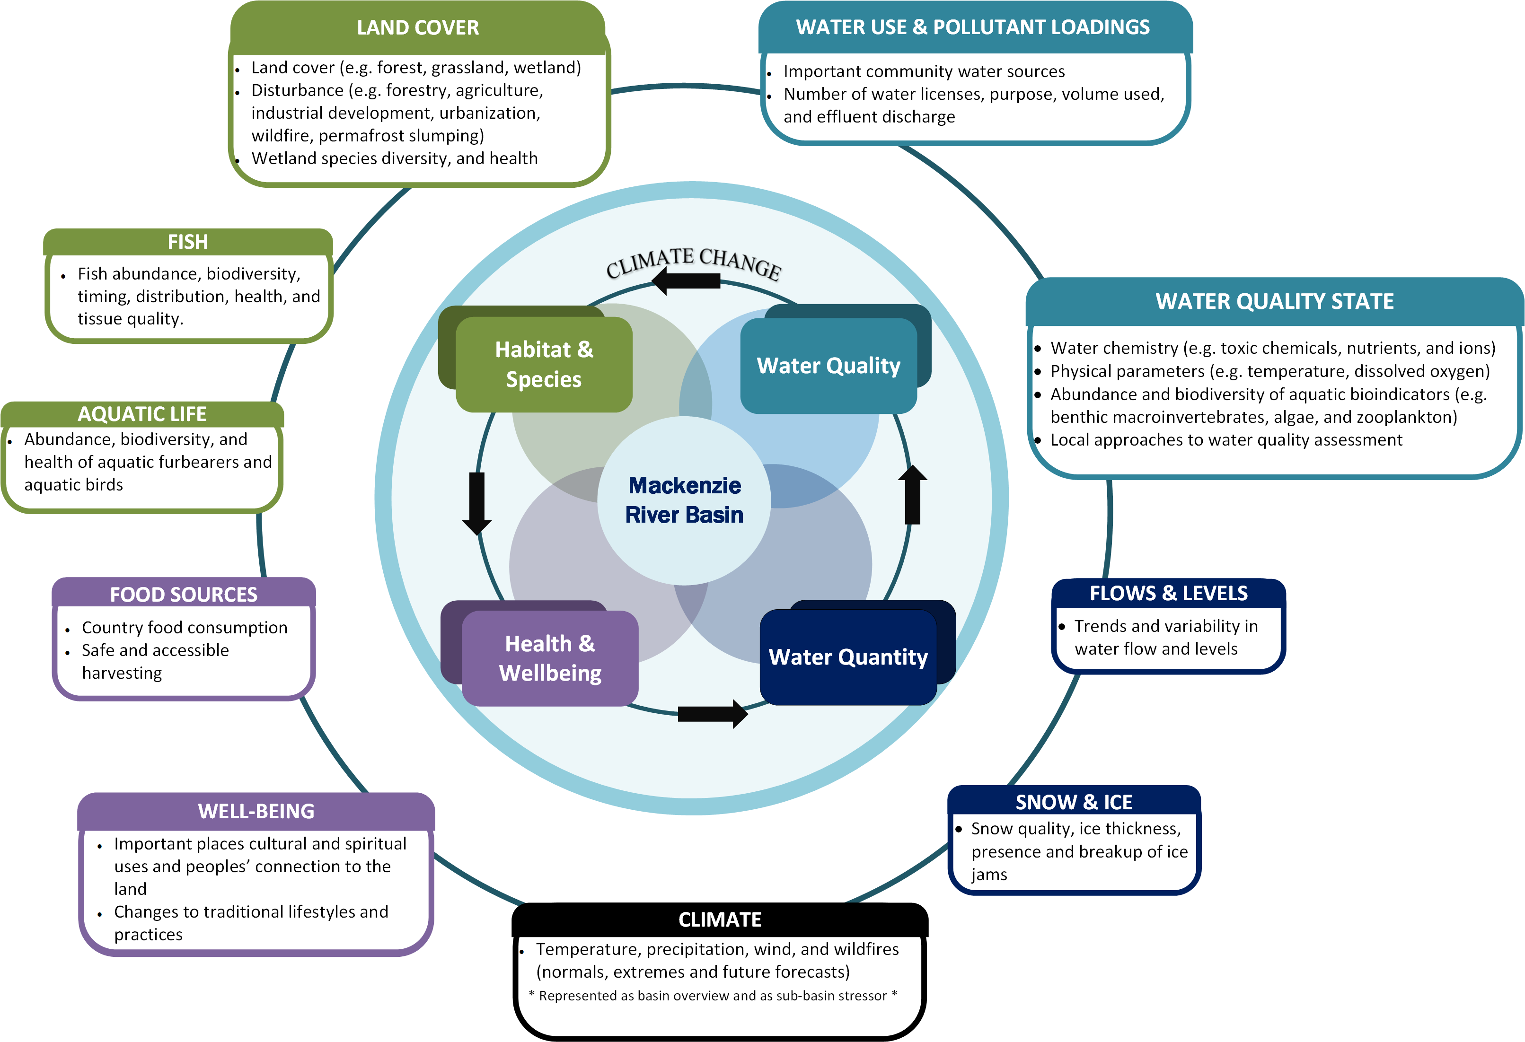
Indicator Assessment

Slide 6
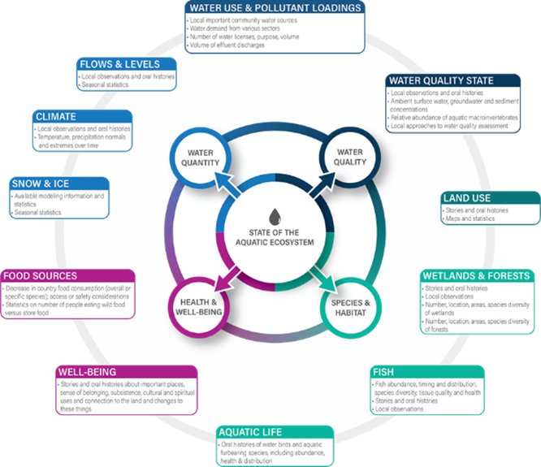
Basin Wide Climate Indicator

Slide 7
Basin-Wide Climate Indicator Workshop
‘Stories of Change’
SOAER Working group agreed to have climate change as its own standalone indicator while also having climate change integrated into the other indicators
Upcoming work:
Joint in-person & virtual workshop to collect basin-wide climate change information through expert’s story-telling
  Experts include Elders, knowledge holders & climate / water scientists and modelers
Steps
Develop MRBB information sharing agreement
Host workshop with representatives across the MRB
Contractor’s workshop report is reviewed and includes permissions to be shared publicly
Integrate the bridged information and stories into the SOAER
  supports climate change as stand-alone indicator and through linkages to other signs/ signals

Slide 8
Bilateral Water Management Agreements: Implementation and Results
Summarize the status of the various BWMAs
Highlight the work of the Bilateral Management Committees (BMC)
  Showcase collaboration, and partnering for transboundary management
  BMC efforts include past successes and ongoing work to bridge across knowledge systems
SOAER content could include text, video, images, audio, maps, StoryMaps

Slide 9
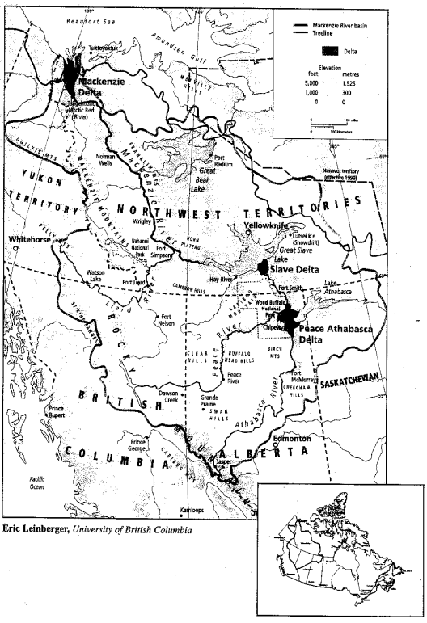
Highlighting Significant Basin Features
The 1997 Mackenzie River Basin Master Agreement Schedule A highlighted the basin’s significant rivers, deltas and large lakes and all were reported in the first 2003 SOAER
SOAER Update
  In addition to major rivers, also highlight major deltas and large lakes with section overviews
Deltas
Peace-Athabasca Delta
Slave Delta
Mackenzie Delta
Large Lakes
Lake Athabasca
Great Slave Lake
Great Bear Lake
MRB Master Agreement, 1997
Schedule A

Slide 10
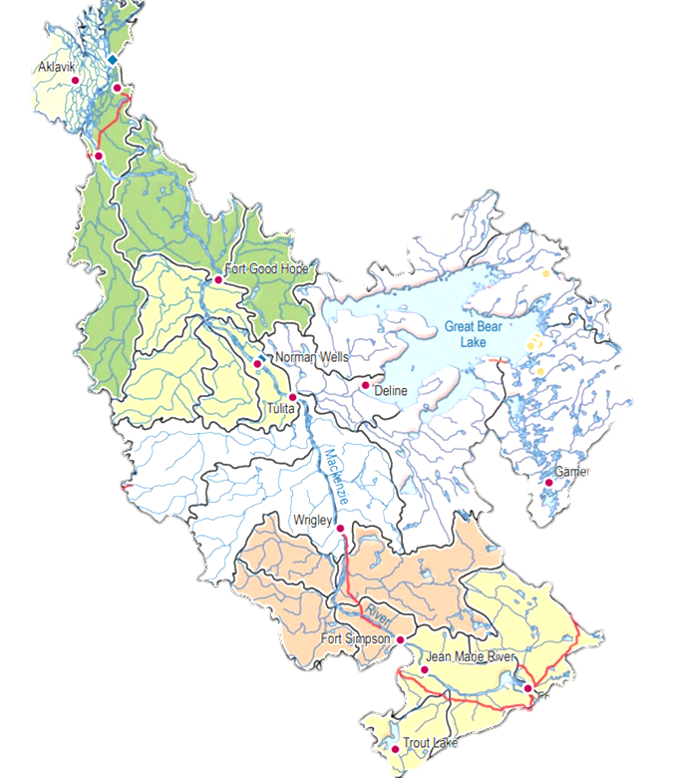
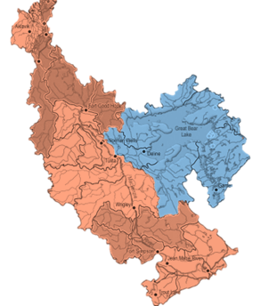
Great Bear / Sahtú Sub-Basin
What:
Separate the ‘Mackenize–Great Bear’ sub-basin into ‘Mackenzie’ and ‘Great Bear’
Why:
The Mackenzie-Great Bear sub-basin is the largest of six in the Mackenzie River Basin (26%)
  Mackenzie: 17%
  Great Bear: 9%
  Peel (for comparison): 4%
Mackenzie River vs Great Bear are hydrological, ecologically, and culturally distinct
Great Bear Lake / Sahtú is the largest lake entirely within Canada
Additional Notes:
Great Bear Lake and watershed is a proposed Indigenous Protected and Conserved Area (IPCA)
SOAER 2021 & 2003 presented mostly distinct data for the Mackenzie River and Grear Bear Lake
Great Bear / Sahtú is the only sub-basin with Nunavut transboundary waters
Notes:
No decision needed at this time.
Will present at next SOAER meeting for group decision.

Slide 11
'Skeleton' Statement of Work

Slide 12
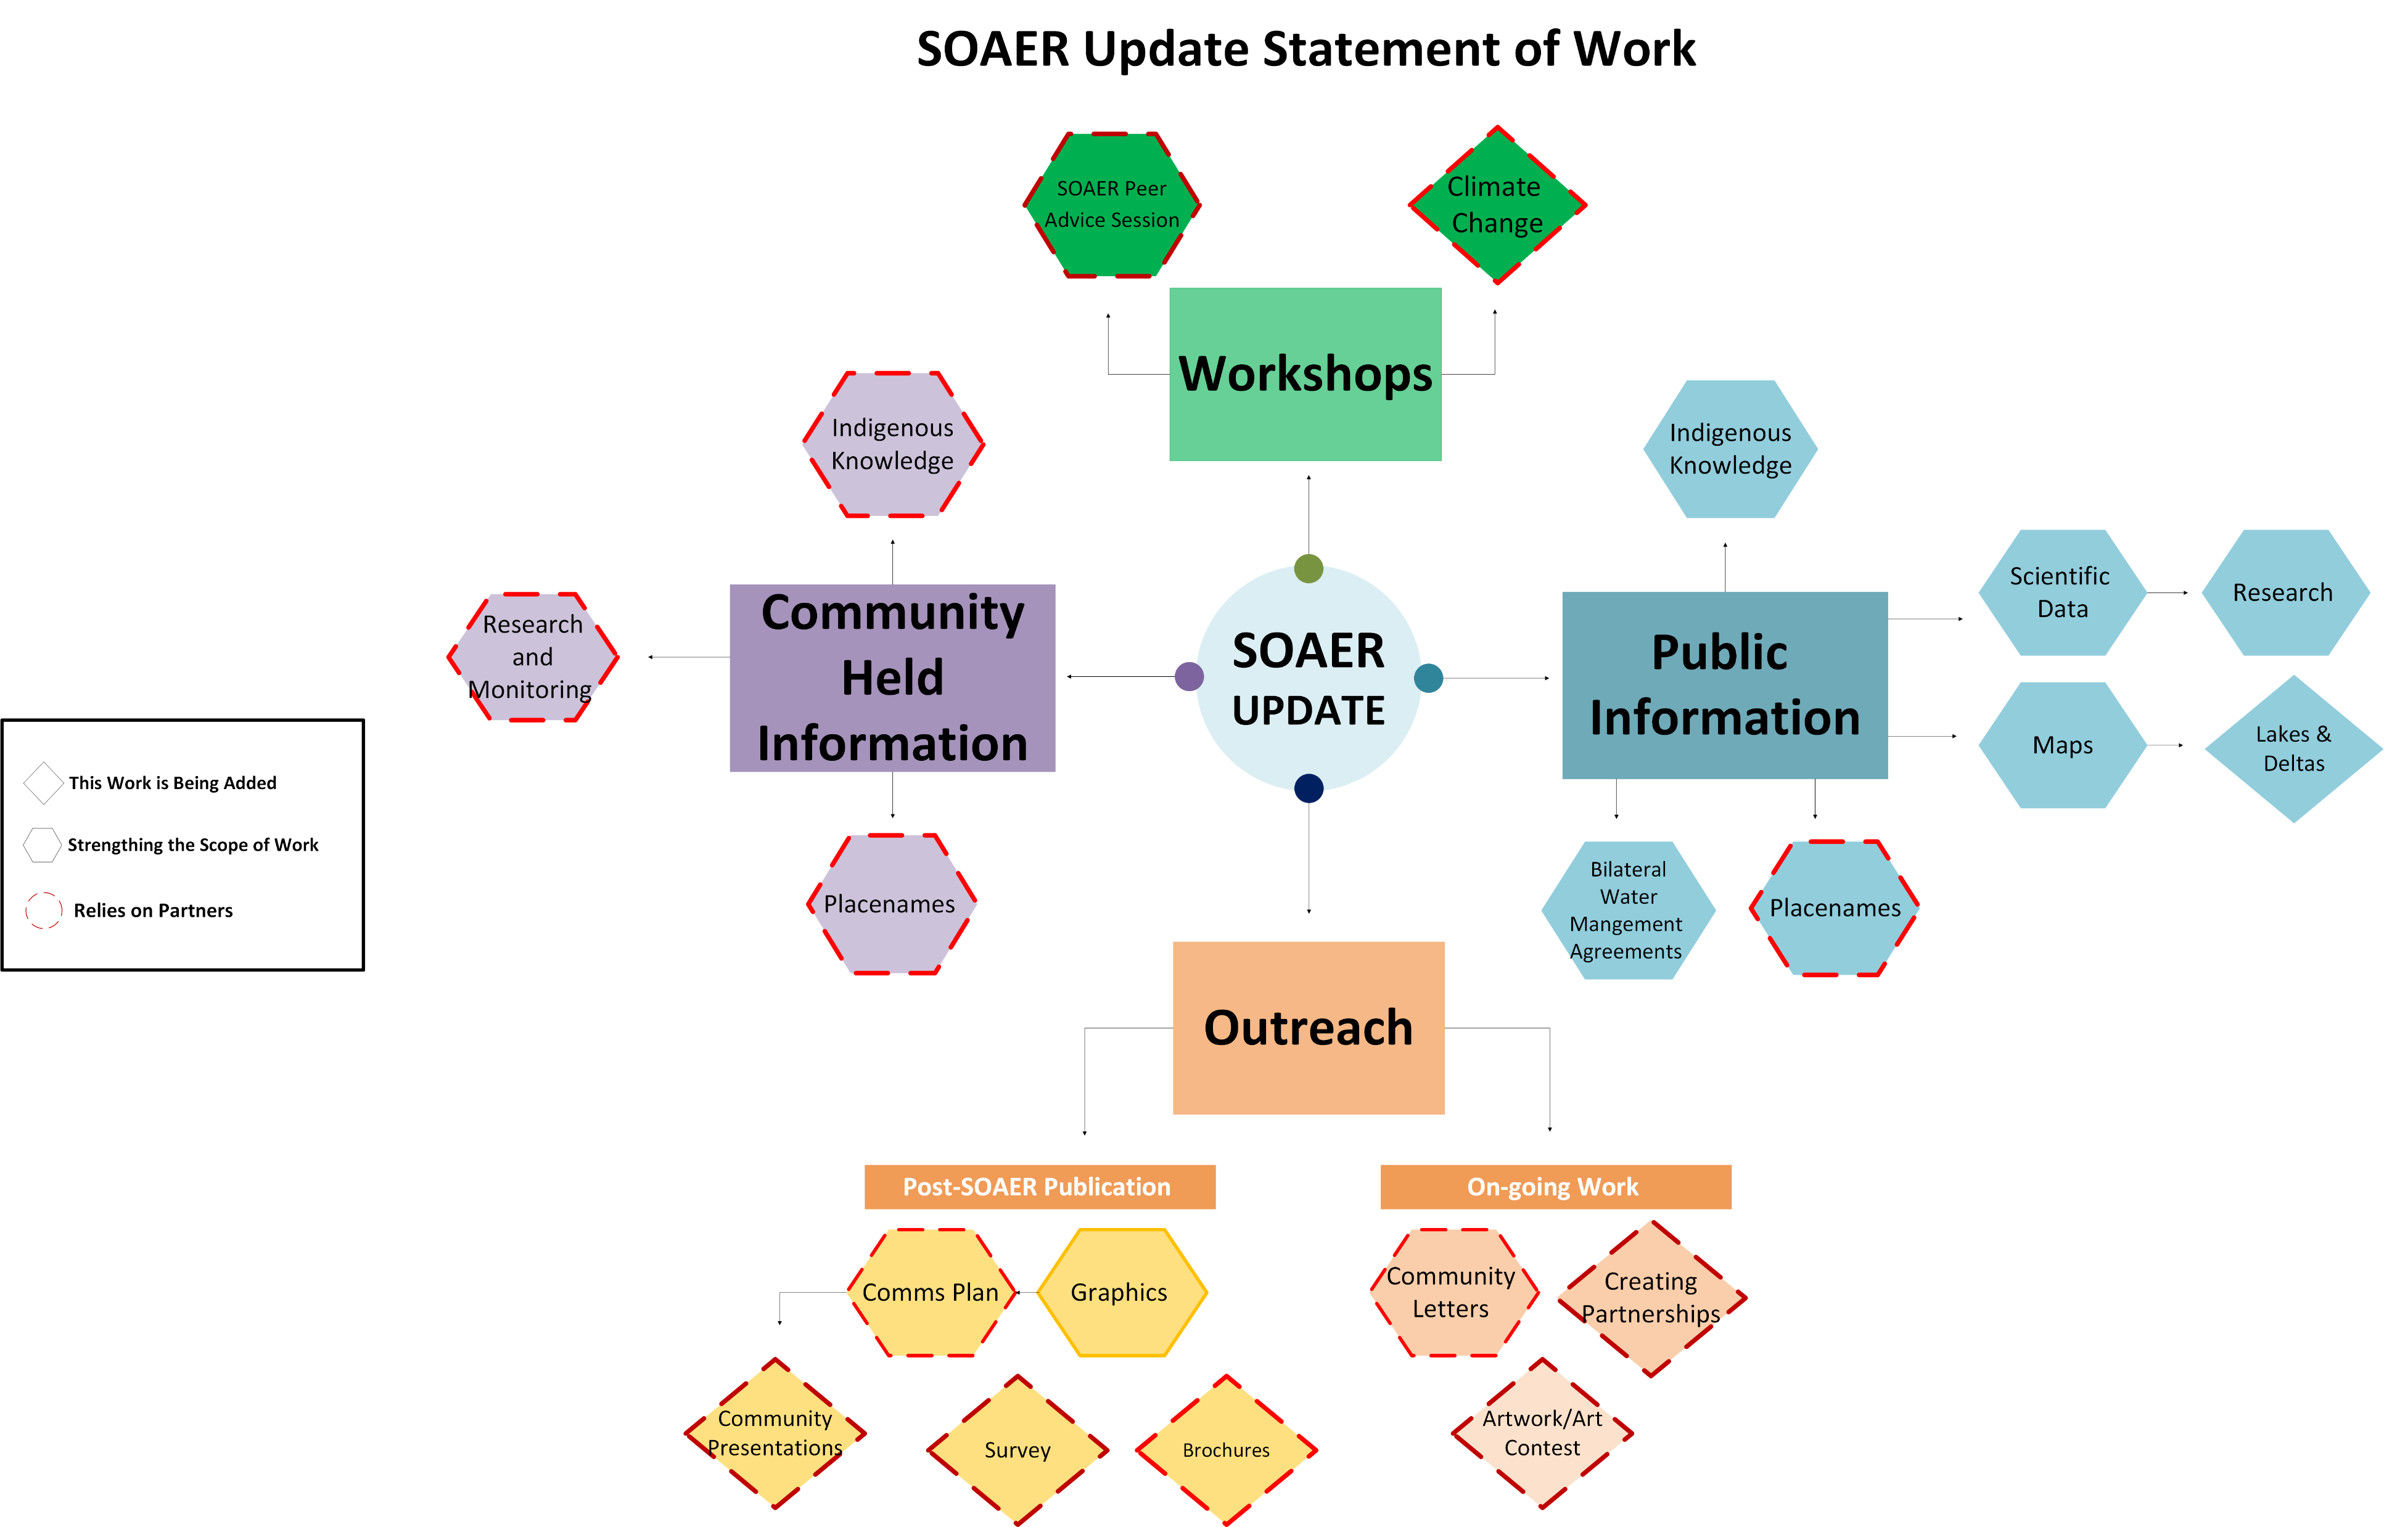

Slide 13
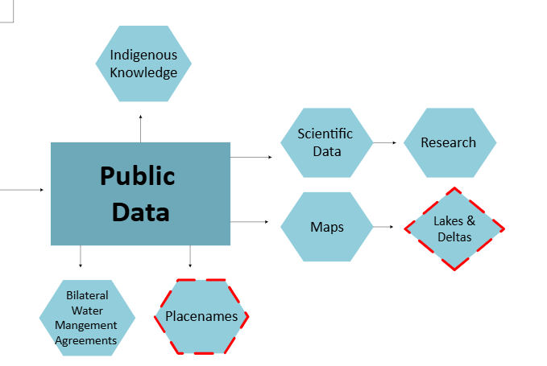
Public Information
Publicly available information (Indigenous knowledge and science) is the ‘backbone’ of the SOAER
Produce updated and improved maps across the basin and sub-basins
Basin-wide reporting on rivers, deltas, and large lakes
New for SOAER Update:
Indigenous placenames
Highlight the work of the BMWAs

Slide 14
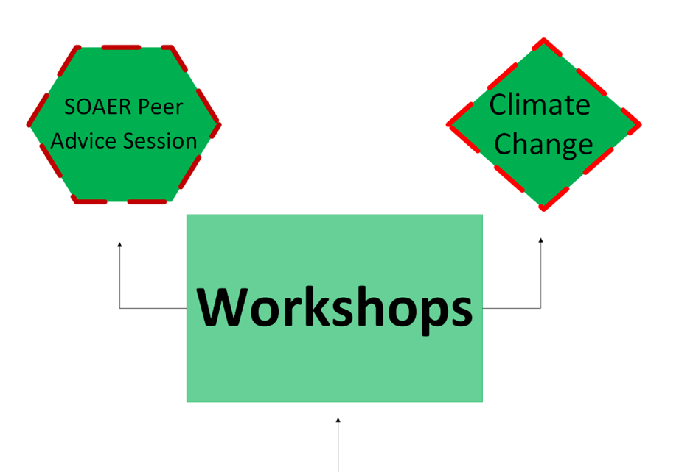
Workshops
Two workshops
  SOAER Peer Advice Session [Virtual]
    Interviews and group discussion with past SOAER experts to seek advise on a principled approach to the SOAER update
    Feedback and reflections on past SOAERs to guide the SOAER update
  Climate Change ‘Stories of Change’
    How is climate change affect the aquatic ecosystem, ecosystem services, and peoples’ health and wellbeing
    Convene a group of experts (Elders, Traditional Knowledge holders and scientists) to bridge knowledge and produce stories of change across the basin to incorporate into the SOAER
[in-person / hybrid]

Slide 16
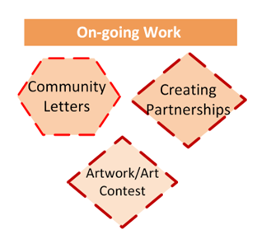
Outreach
In 2018-19, Indigenous members of the MRBB sent letters to Indigenous governments and communities in the basin that informed recipients about the plan to develop an online State of the Aquatic Ecosystem Report.
MRBB Secretariat has shared the SOAER at multiple venues. Many living in the basin are not aware of the MRBB or the SOAER..
Outreach could be key to establishing new partnerships and addressing important data gaps.
MRBB members are better connected to work being done in the basin that could be profiled on the SOAER.
Outreach is scalable.

Slide 17
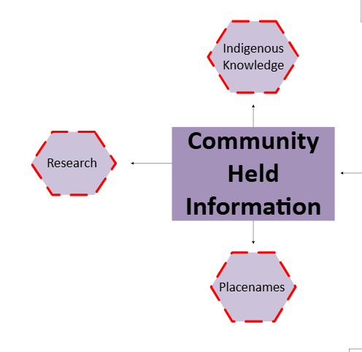
Non-Public Information
SOAER 2021 noted gaps with publicly available Indigenous Knowledge (IK)
  IK is held by communities and often not public
The SOAER update will bridge IK with science equally for a holistic understanding of aquatic ecosystem health
Indigenous government and Indigenous organizations are leading more research and monitoring which can be profiled on the SOAER
Consent/data sharing agreements may be required
Indigenous placenames of important places can have both cultural and ecological meaning

Slide 19
2025-26 Budget – SOAER contracts
Proposed budget currently includes work that the Secretariat and committees can initiate and direct
The contract for the update of publicly available information can be scoped; this budget estimate includes a similar overall level of effort and output from the 2019 contract
Multiyear contract that includes planned pauses to allow committee members to respond to priority items
Item | Budget
SOAER Climate Workshop | $95,000.00
SOAER Feedback Workshop | $15,000.00
SOAER –Update of publicly available information 2025-26 | $30,000.00
SOAER –Update of publicly available information 2026-27 | $279,000.00
sub-total | $419,000.00

Slide 20
Budget Envelope
The SOAER has a lot of potential and investment could be significant.
SOAER Committee members considered the overall goal of the report, key priorities and available resources.
The work proposed has been scaled to focus on important pieces.
MRBB members have approved human resources to support the SOAER update
Discussion to establish a shared understanding about project budget. MRBB Secretariat and committee would appreciate an idea of the envelope available.

Slide 21
Financial Implications for 2026-27
Item | Budget
SOAER Contracts (includes multiyear contract) | $419,000.00
Anticipated Carry Forward (2025-26) | $694,575.02
2026-27 Contributions | $280,000.00
Funds Remaining to Support Routine Business and Additional Contracts in 2026-27 | $555,575.02

