Slide 1
SOAER Discussion
MRBB Meeting 83 Supplemental

Slide 2
2021 SOAER Timeline
2003
First Published SOAER
2012
Issues Report Published as an update to the 2003 report
2013
Workshop to develop potential indicators
SOAER Committee revived
2015
Tracking Change launched. MRBB Indigenous members served as Indigenous Steering Committee (SHIRC funds)
2016
IISD report identifies potential indicators for the SOAER (NWT contract)
2017
Workshop to explore co-presentation of science and Indigenous knowledge (Dettah NWT)
2018/19
SoW developed for a web based SOAER
2019
Contract signed with Associated Environmental to develop a web-based SOAER
2021
MRBB online State of the Aquatic Ecosystem Report goes live

Slide 3
SOAER Update – Foundational Elements
Time between State of Report updates has decreased (positive)
Less time to "save up" for large contracts
Partners and BWMAs have supported SOAER update planning and information sources
2021
Virtual Priority Setting Exercise (MRBB Secretariat)
2022
SOAER Committee Workshop (hybrid) (MRBB Secretariat)
2023
University of Calgary Workshop (ECCC funds)
2024
SOAER Session at NWT Water Stewardship Meeting (NWT)
Liard Elders Circle "What We Heard" report (BC/Yukon/NWT BWMA)
2025
Water Quality Task Team trends contract (AB NWT BWMA)

Slide 4
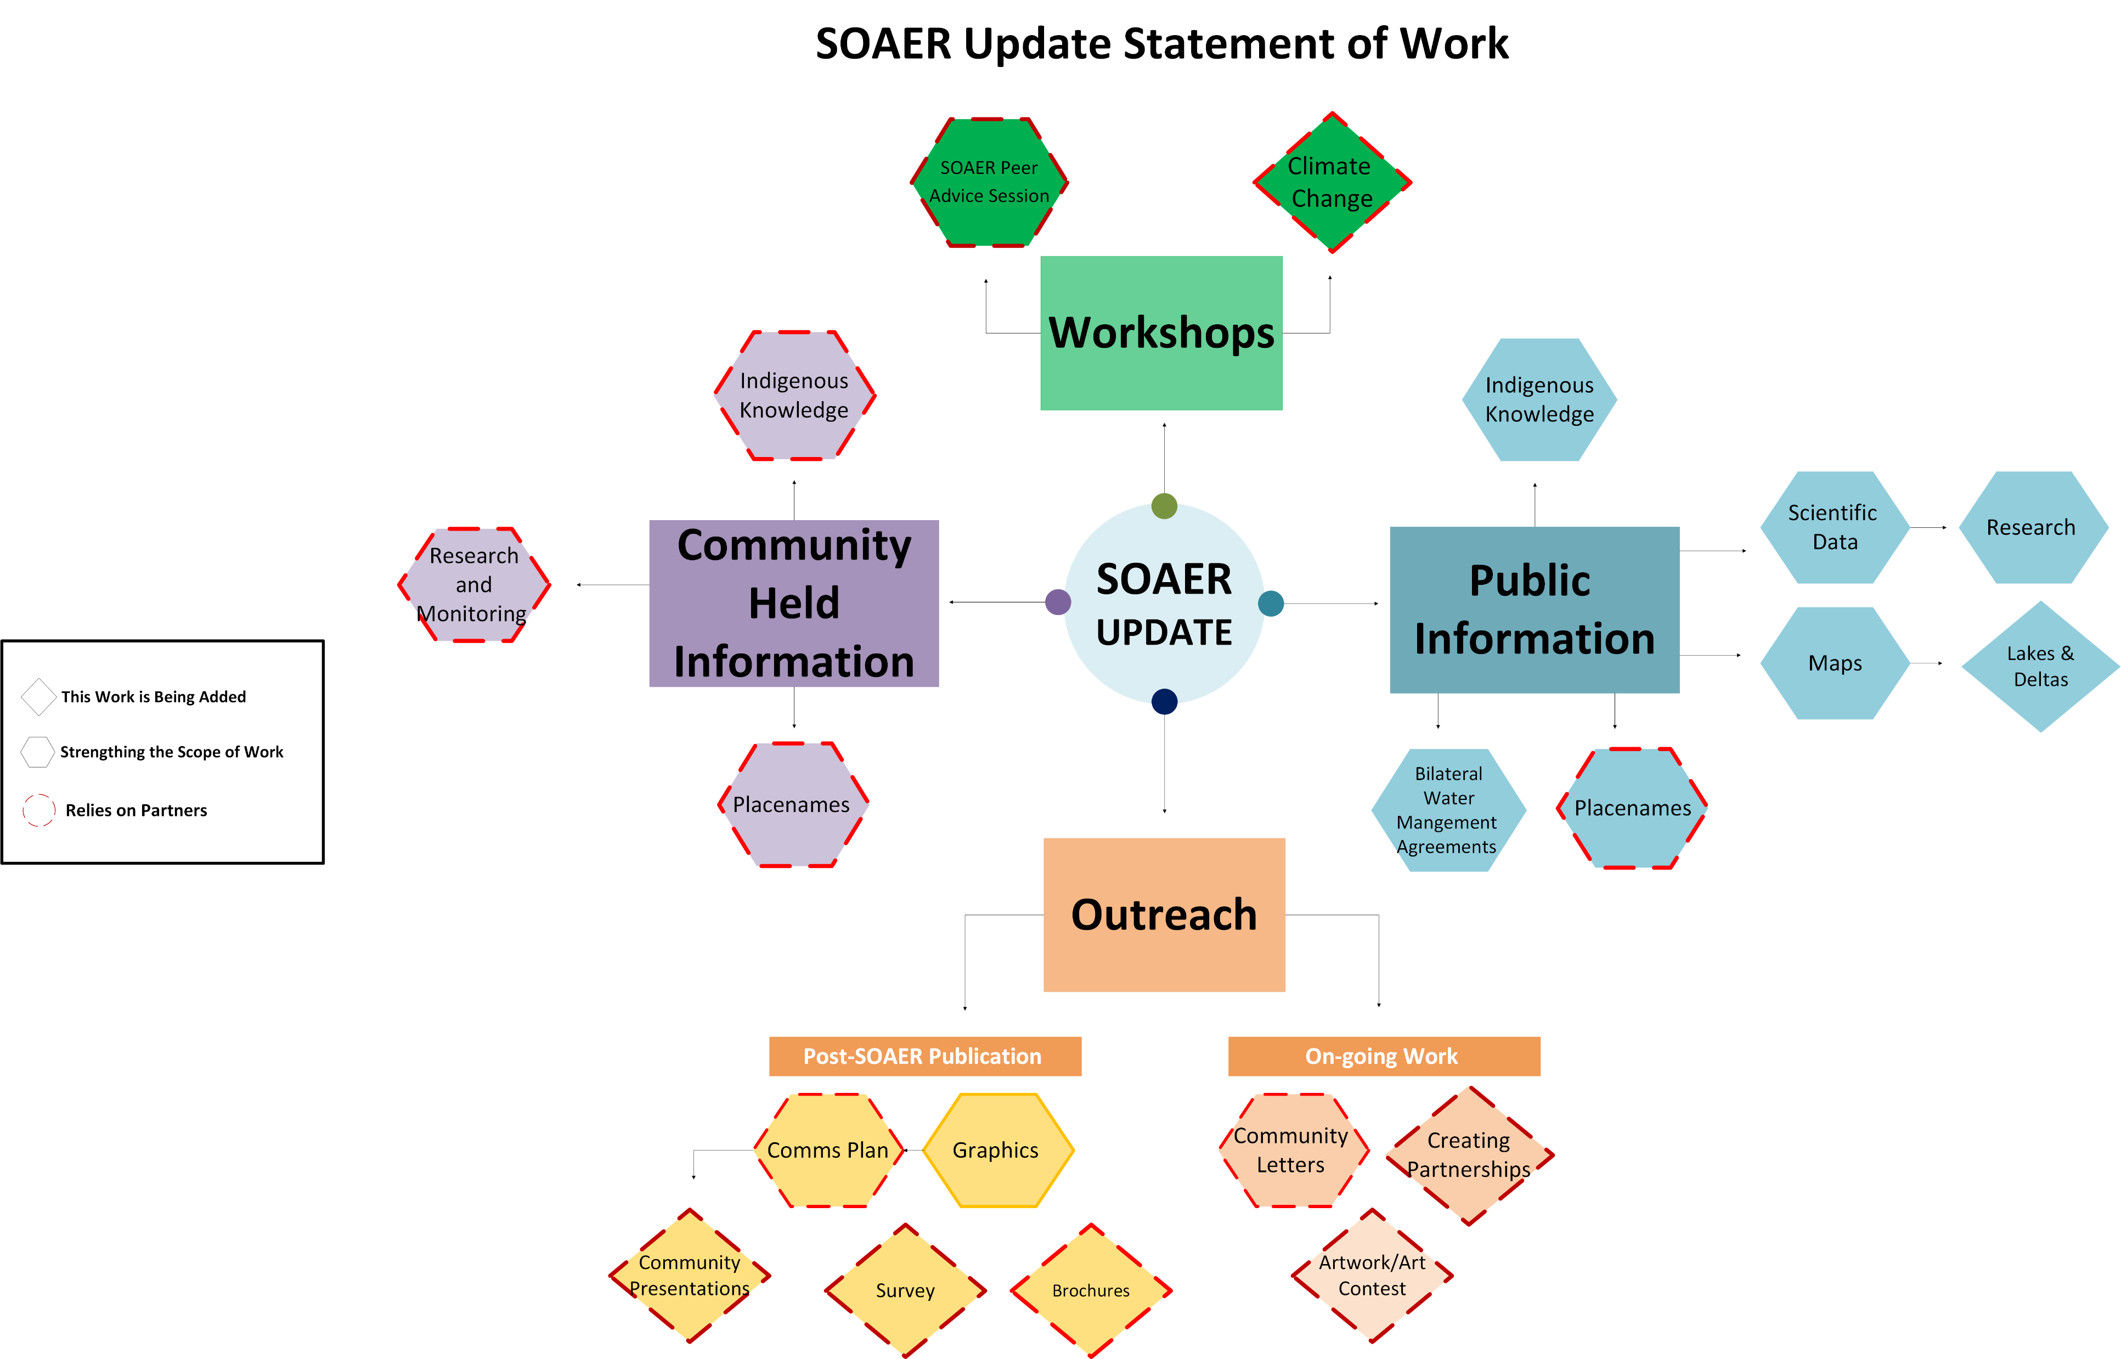

Slide 5
Budget Envelope
The SOAER has a lot of potential
SOAER Committee members considered the overall goal of the report, key priorities and resources.
Proposed work is aligned with areas of focus and includes flexibility to include on-going work
This discussion builds on the high-level overview shared at MRBB Meeting 83.

Slide 6
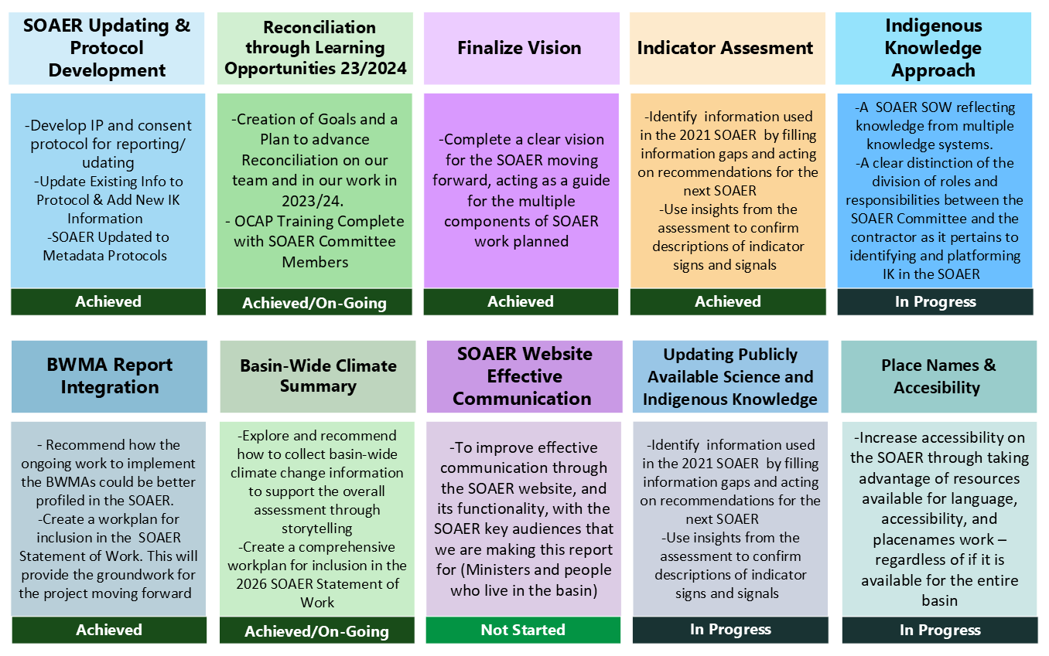


Slide 7
2025-26 Budget – SOAER
Proposed budget includes work that the Secretariat and committees can initiate and direct
The contract for the update of publicly available information can be further scoped
Timing and format of climate workshop(s) can be revisited, and partnerships can be explored
Item | Budget
SOAER Climate Workshop | $95,000.00
SOAER Feedback Workshop | $15,000.00
SOAER –Update of publicly available information | $309,000.00
sub-total | $419,000.00

Slide 10
Peer Advice Session to support inclusion of Indigenous Knowledge on the SOAER
The SOAER Committee and the consultant must agree on the approach for respectfully working with publicly available Indigeous knowledge and information shared by Indigenous Knowledge holders and Indigeous governments and communities.
2019 SOAER relied on a peer reviewed publication for guidance.
SOAER Committee members support a principled approach for the update.

Slide 11
Peer Advice Session to support inclusion of Indigenous Knowledge on the SOAER
Contract to convene a virtual "peer advice" session ($15,000)
Interviews and group discussion with past SOAER experts to seek advice on a principled approach to guide the SOAER update
Access the expertise in the MRB community that exists outside of the current SOAER Committee
Principles will guide current and (hopefully) future SOAER updates
(WWH Meeting 83) Concern about creating an echo chamber
expand the group to include experienced individual(s) not associated with the current online SOAER or the MRBB

Slide 13
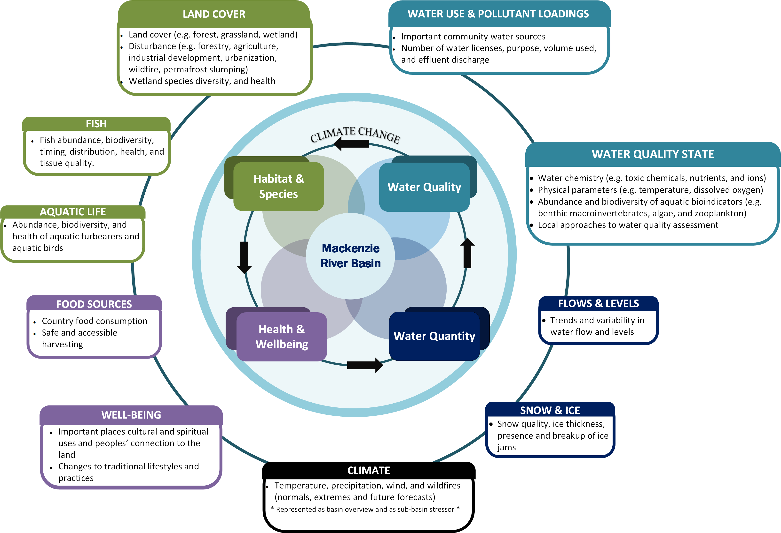
Indicator Assessment

Slide 14
Basin-Wide Climate Indicator Workshop ‘Stories of Change’
Support climate change as a standalone indicator ($95,000)
Joint in-person & virtual workshop to collect basin-wide climate change information through expert’s story-telling
Experts include Elders, knowledge holders & climate / water scientists and modelers
Contract Steps
Develop MRBB information sharing agreement
Host hybrid workshop with representatives across the MRB
Contractor’s workshop report is reviewed and includes permissions to be shared publicly
Integrate the bridged information and stories into the SOAER
supports climate change as stand-alone indicator and through linkages to other signs/ signals

Slide 16
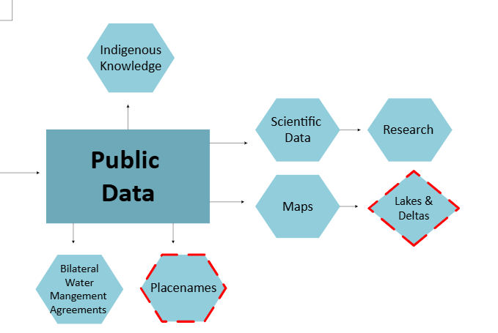
Public Information
Publicly available information (Indigenous knowledge and science) is the ‘backbone’ of the SOAER
Produce updated and improved maps across the basin and sub-basins
Basin-wide reporting on rivers, deltas, and large lakes
WQTT will produce science-based water quality trends for the SOAER ($100,000.00 budget; contract funded through the AB-NWT BWMA)
Bulk of the expense associated with the SoW contract
New for SOAER Update:
Indigenous placenames
Highlight the work of the BMWAs
Profile 3 largest lakes and deltas

Slide 17
BWMA – Information and Processes
There is already a BWMA section on the MRBB website.
Intent: 1) ensure integration of information collected and 2) highlight approach(es) to working with different knowledge systems
(WWH meeting 83) Concern about jurisdictional capacity
Recommend SOAER update pull pre-approved language from the BWMA annual reports ​
Specific line item cost would be largely associated with documenting work in progress to respectfully include Indigenous Knowledge.
MRBB Secretariat met with Kátł’odeh Basin Indigenous Community-based Monitoring Program Partner Team (Aug 2024), Peel BMC (June 2024) and AB-NWT BMC (May 2024). Follow up may be required.

Slide 18
Place Names and Online Content
Content is increasingly available online but permission must be sought around use.
Can information from the site be used in the SOAER? If not, can SOAER direct users to a site?
Are content creators comfortable with the SOAER referencing parts of a product?
Resources required from MRBB secretariat and contractor to ensure content is included in an acceptable way throughout the report
Liard "What We Heard Report"
Treaty 8 Place Names Atlas : Treaty8 Place Names
Gwich'in Place Names Atlas: Gwich'in Place Names Atlas
Content that could augment the SOAER:
The Copper People. | By YKDFN | Facebook
Land of the Ancestors - Land of the Ancestors
Wisdom from the Watershed - Arctic Inspiration Prize

Slide 19
Updating Publicly Available Information
2019 Contract – Budget breakdown
SOAER Update
Based on previous contract but refined based on experience
Data discovery – 2021 information; Tracking Change contract (2023) ; proactive identification of information sources; Stats Can information
Indicator Analysis – foundation is there; science based water quality trends will be completed by the WQTT
Website Design – build upon existing; add interactive maps; adjust to include great Bear sub-basin; link to existing video and material on other sites (requires outreach)

Slide 20
Updating Publicly Available Information
2019 Contract – Budget breakdown
SOAER Enhancements
Address data gaps and reflect what we heard at workshops
Lakes and Deltas – profile the 3 largest lakes and the 3 deltas; outreach recommended
BWMAs – highlight work in the basin that bridges knowledge systems; part of the SoW contract; requires outreach
Place names – link to online resources and include place names in SOAER content; part of the SoW; requires outreach
Climate – workshop to engage knowledge holders and generate information for the SOAER (currently proposed as outside the SoW contract); requires outreach

Slide 21
SOAER Budget
2019 SOAER Contract
Cost of Recent Workshops and Videos
2021 SOAER cost in 2019 dollars: $259,900.00
Proposed budget envelope for SOAER update is $309,000.00
2021 SOAER cost in 2025 dollars: $312,200.00
~20% inflation in six years
MRBB Video (2022-23): $39,900.00
10 min video. What is the MRRB, vison, goals, members, and the SOAER
ECCC contact
U of C workshop (2023): $129,640.00
In person workshop. Representatives from the basin discussed ideas and recommendations for accessible ‘State of’ reporting
ECCC grant

Slide 22
Outreach
In 2018-19, Indigenous members of the MRBB sent letters to Indigenous organizations in the basin that informed recipients about the plan to develop an online State of the Aquatic Ecosystem Report. MRBB Secretariat has shared the SOAER website at multiple venues.
Outreach could be key to establishing new partnerships and addressing important data gaps. Members of the MRBB Secretariat have started to connect with existing network. There are other possible collaborators that we could connect with (i.e. Global Water Futures, Arramat).
Current approach requires outreach to link to existing material, profile bridging at BMCs, develop a robust climate section and ensure support to include online content.
MRBB Secretariat intends to reconnect with B. Parlee to seek advice on advising holders of current knowledge on the SOAER of the update.

Slide 23
Outreach
Summer/fall 2025 – MRBB Secretariat and TKSP Committee members send letters/emails informing recipients of intent to update the SOAER. Share update priorities.
Fall/Winter 2025 - MRBB Secretariat and TKSP Committee members send letters/emails informing recipients that the contract has been awarded and invite those interested in sharing information to contact MRBB secretariat and/or contractor.
Tailored messages as required for climate change workshop, BMCs, owners of online information, videos and placenames.
Recipients – Indigenous organizations, academic partners, funding program managers, others?
Support Required - Secretariat does not have a database of contact information

Slide 24
Draft letter and details to sort out
Draft letter is included in the meeting package as an example. This letter is based on drafts of the 2019 letter sent by MRBB Indigenous members.
Paper copy or email or both?
Last time it appears one letter went to a list of people. is this a good path forward?
Last time it appears that provincial/territorial MRBB members provided lists of contacts (names/addresses) to the MRBB secretariat. Is this is the best way to get contact information? Are there other ways?
Should the letter be sent to leadership or land managers?

Slide 26
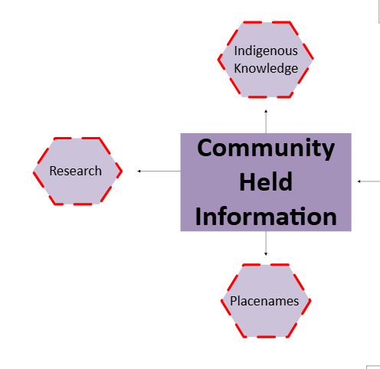
Non-Public Information
SOAER 2021 noted gaps with publicly available Indigenous Knowledge (IK)
IK is held by communities and often not public
The SOAER update will bridge IK with science equally for a holistic understanding of aquatic ecosystem health
Indigenous government and Indigenous organizations are leading more research and monitoring which can be profiled on the SOAER
Consent/data sharing agreements may be required
Indigenous placenames of important places can have both cultural and ecological meaning

Slide 27
Non-Public Information
Hope that Indigenous governments and organizations in the basin will be interested in sharing information on the SOAER
If partners step forward early, information could be included as part of the update produced by the SOAER update SoW.
If information is shared later, it could be added to the site (level 2 or 3 approval) and included in overall assessment at next update
May need to explore funding options available for analysis or knowledge mobilization

Slide 28
5 Year Forecast
 | 2025-26 | 2026-27 | 2027-28 | 2028-29 | 2029-30
Salary | $247,874.00 | $210,114.00 | $212,741.00 | $215,932.00 | $219,171.00
Routine Expenses | $53,000.00 | $58,100.00 | $58,200.00 | $58,300.00 | $58,400.00
Routine Contracts | $6,500.00 | $3,500.00 | $3,500.00 | $3,700.00 | $3,700.00
SOAER Contracts | $140,000.00 | $297,000.00
Budget Estimate | $447,374.00 | $568,714.00 | $274,441.00 | $277,932.00 | $273,489.00
Carry Over | $554,575.00 | $265,861.00 | $271,420.00 | $273,489.00 | $272,218.00

Slide 29
2025-26 Budget – SOAER
Decision: approve the budget as outlined or give guidance on budget envelope
Is more information required?
Consider further scoping or deferring components?
Is there information or are there opportunities that may change the proposed approach?
Item | Budget
SOAER Climate Workshop | $95,000.00
SOAER Feedback Workshop | $15,000.00
SOAER –Update of publicly available information 2025-26 | $30,000.00
SOAER –Update of publicly available information 2026-27 | $279,000.00
sub-total | $419,000.00

Slide 30
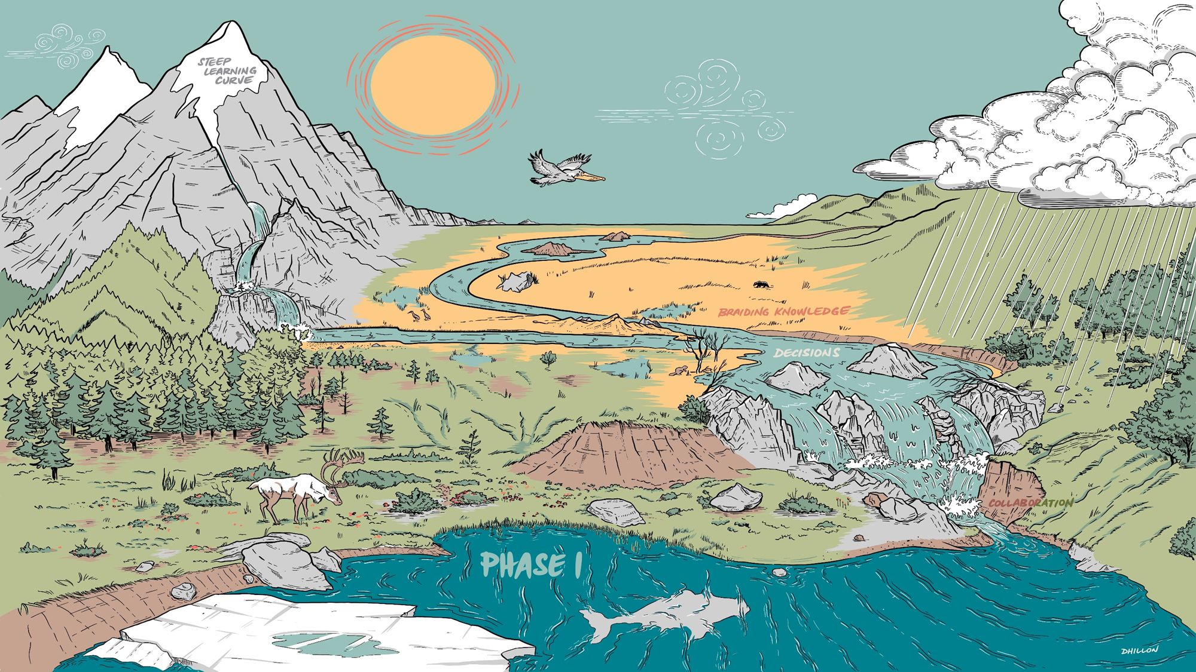
Questions/Discussion

