Slide 1
SOAER Update: Outreach

Slide 2
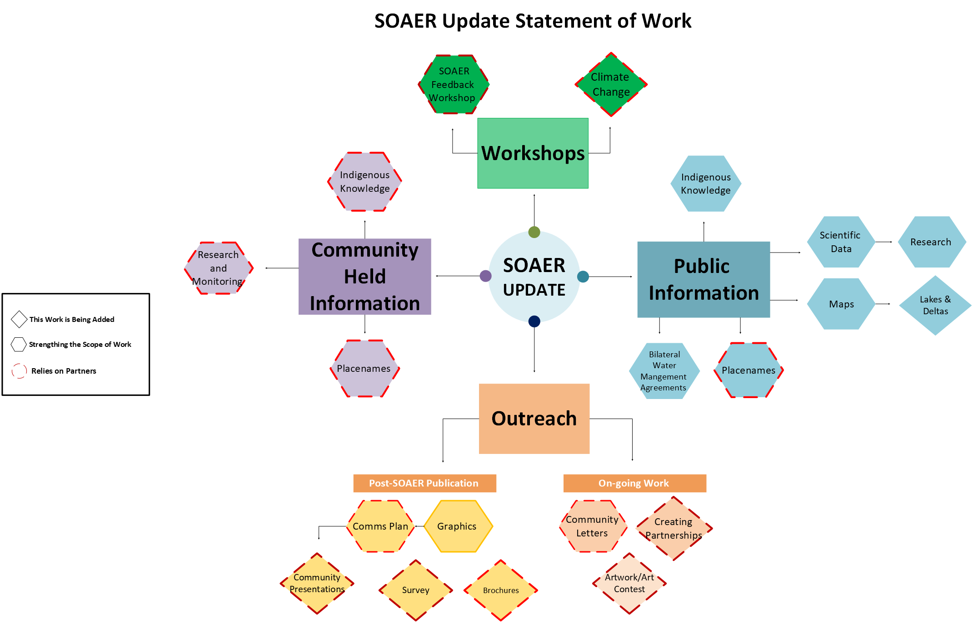

Slide 3
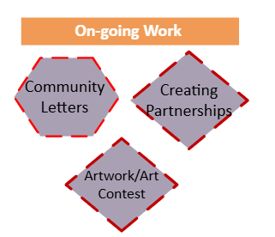
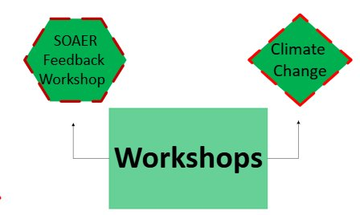
Outreach
In 2018-19, Indigenous members of the MRBB sent letters to Indigenous governments and communities in the basin that informed recipients about the plan to develop an online State of the Aquatic Ecosystem Report.
MRBB Secretariat has shared the SOAER at multiple venues. Many living in the basin are not aware of the MRBB or the SOAER..
Outreach could be key to establishing new partnerships and addressing important data gaps.
MRBB members are better connected to work being done in the basin that could be profiled on the SOAER.
Outreach is scalable.

Slide 4
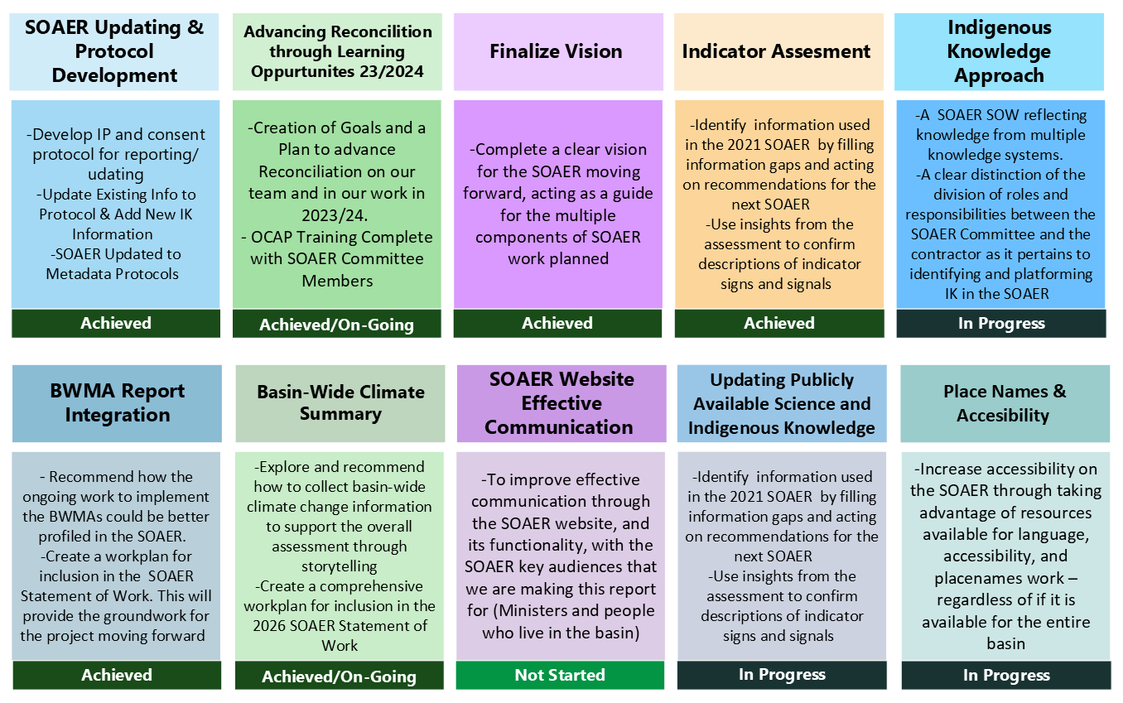


Slide 5
Outreach – Who is sending out messages and What should they send
Who
Materials
MRBB member
BWMA/BMC co-chairs/members
Traditional Knowledge and Strengthening Partnerships Committee member
MRBB Secretariat
Letters
Graphics (i.e. indicators)
Surveys (requires development)
Brochure (requires development)
Artwork: youth art contest of indicators

Slide 6
Outreach
TKSP committee has discussed outreach, and members are interested in sending letters to Indigenous organizations in the basin.
Different government programs may be doing work that could be profiled on the SOAER. MRBB government members could reach out within their organizations.
Likely need a place-based approach for BMCs. MRBB secretariat could reach out or MRBB members that hold leadership roles – advice?
Academics and partners: MRBB secretariat has a small network that could be enhanced.

Slide 7
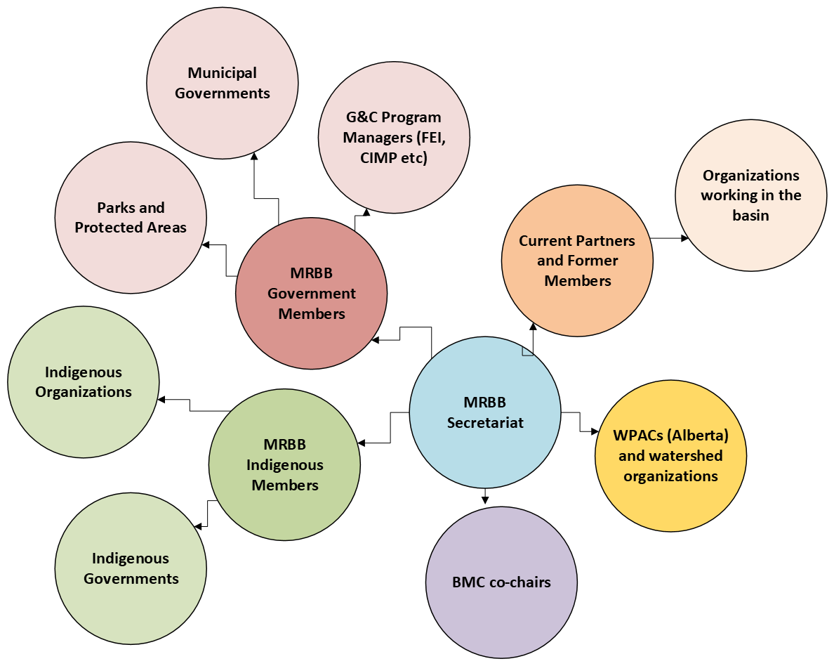

Slide 8
Considerations
Audience: one standard letter for everyone (one size fits all) may not be the best approach.
Location in the basin: Is there value in considering a sub-basin or jurisdiction level approach?
Contact Information: Secretariat does not have contact information and requires support to ensure the right message makes it to the right person in the right format (paper letter, email, fax etc.)

Slide 10
Art Contest
Idea has been floated repeatedly since 2019; could be a good way to involve youth in the basin.
Art work would displayed on the SOAER.
Requires support of external organizations to organize contest, collect and judge submissions and award prizes.
Could be focused on one sub-basin as a pilot.

